Slide 1
Object Oriented Programming
Week 5
Abeer GAUHER
Email: abeer.gauher@nu.edu.pk
Office: CS BASEMENT 2, Office number 17

Slide 2
Static Members of a C++ Class
We can define class members static using static keyword.
When we declare a member of a class as static it means no matter how many objects of the class are created, there is only one copy of the static member.
A static member is shared by all objects of the class.

Slide 3
Static Members of a C++ Class
It can be initialized outside the class using the scope resolution operator :: to identify which class it belongs to.
All static data is initialized to zero when the first object is created, if no other initialization is present.

Slide 4
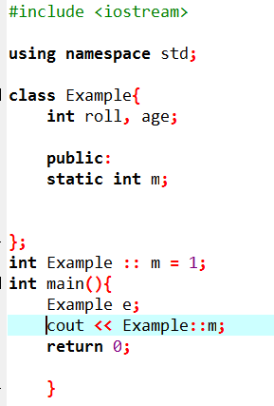
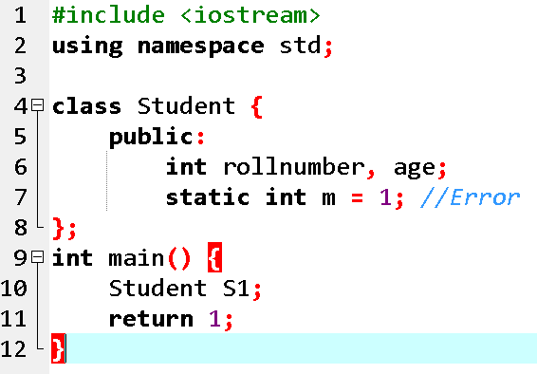
Concept: Static Members can be initialized outside the class

Slide 5
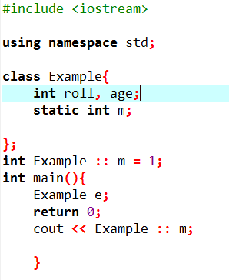
Concept: Static Members can be initialized outside the class

Slide 6
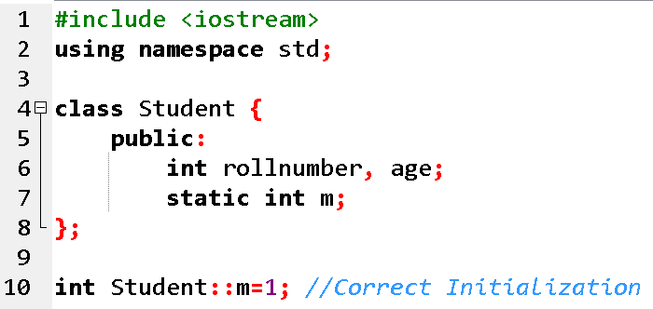
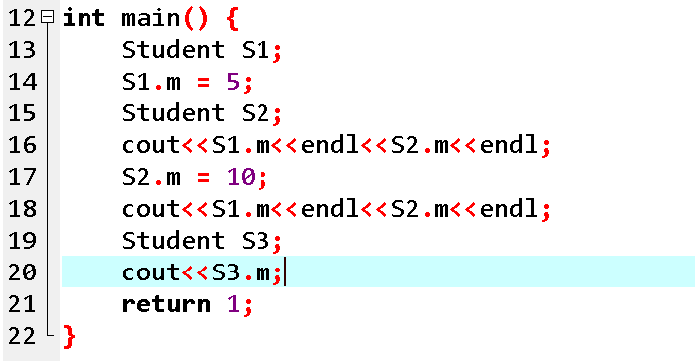

Concept: A static member is shared by all objects of the class

Slide 7
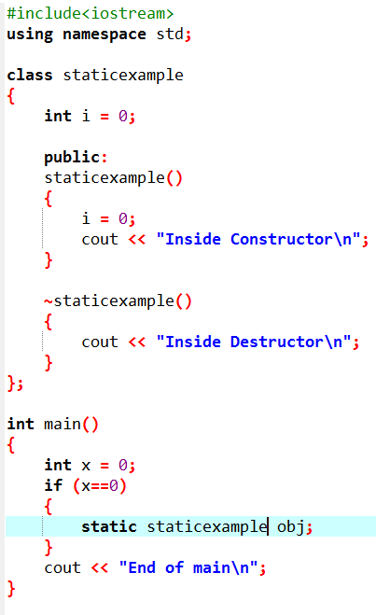

Concept: Static Objects
The destructor is invoked after the end of main.
This happened because the scope of static object is through out the life time of program.
Static creates object on stack means storage is allocated on stack.
Static object are initialized only once and live until the program terminates.

Slide 8
Static Member Functions of a C++ Class
By declaring a function member as static, you make it independent of any particular object of the class
A static member function can be called even if no objects of the class exist and the static functions are accessed using only the class name and the scope resolution operator ::.

Slide 9
Static Member Functions of a C++ Class
A static member function can only access static data member, other static member functions.

Slide 10
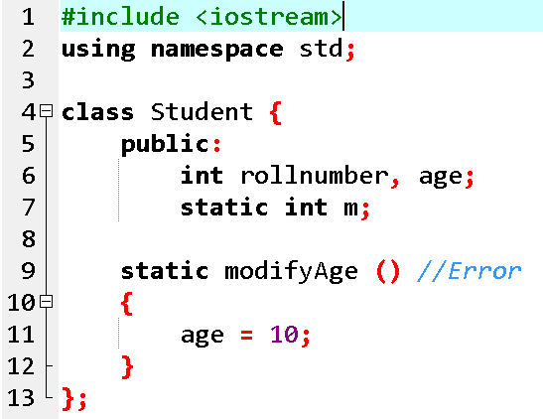
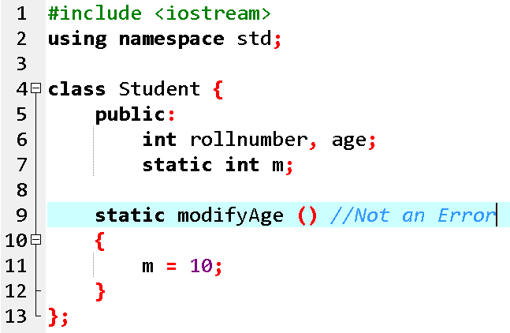
Concept: A static member function can only access static data member

Slide 11
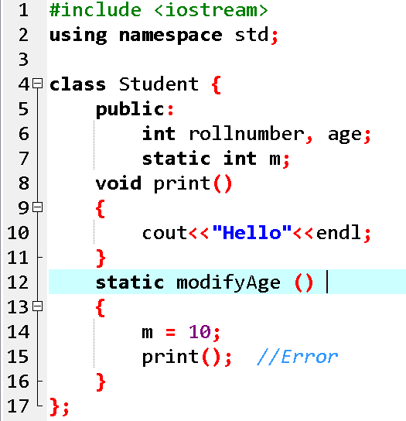
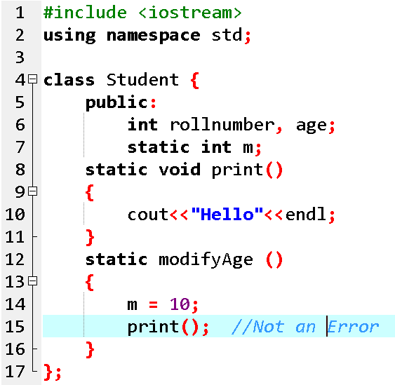
Concept: A static member function can only access other static member functions

Slide 12
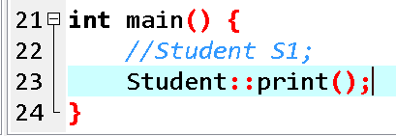
Concept: A static member function can be called even if no objects of the class exist

Slide 13
Inline Functions
Placing the qualifier inline before a function’s return type in definition “advises” the compiler to generate a copy of the function’s code in place (when appropriate) to avoid a function call
Compiler usually ignores this request unless the function does not have too much code

Slide 14
Inline Functions
inline void square(int a)
{
cout << "Square of given number is: " << a * a;
}
int main()
{
int a = 2;
square(a);
}

Slide 15
Inline Functions
inline void square(int a)
{
cout << "Square of given number is: " << a * a;
}
int main()
{
int a = 2;
square(a);
}
Inline functions are used to reduce the function call. When one function is being called multiple times in the program it increases the execution time, so inline function is used to reduce time and increase program efficiency.
If the inline function is being used when the function is called, the inline function expands the whole function code at the point of a function call, instead of running the function.
Inline functions are considered to be used when the function is small otherwise it will not perform well.

Slide 16
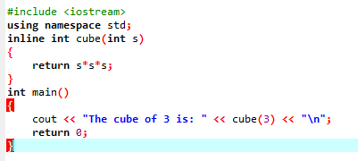
Inline Functions

Slide 17
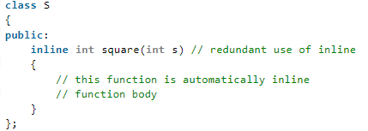
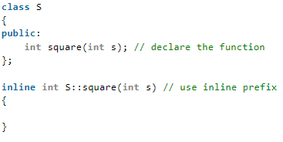
Inline Functions
Inline function and classes:
The above style is considered as a bad programming style. The best programming style is to just write the prototype of function inside the class and specify it as an inline in the function definition.

Slide 18
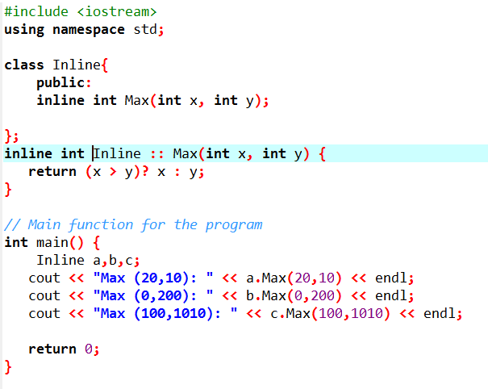

Inline Functions
Inline function and classes:

Slide 19
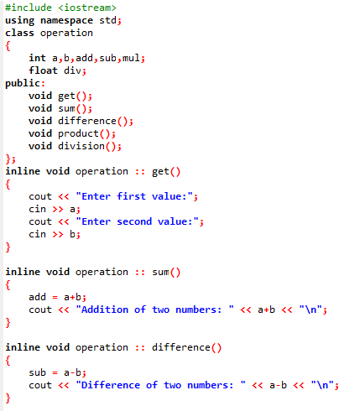
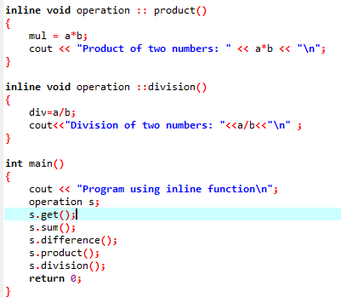
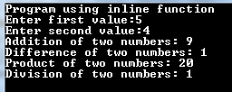
Inline Functions

Slide 20
Inline Functions
Compiler does not perform inlining when:
1) If a function contains a loop (increases number of instruction in program and take more time to execute).
2) If a function contains static variables (requires the same code for several time in the same program , so it is not possible to make a variable static inside the inline function)
3) If a function is recursive (every call to itself is replaced with the body of the function, consumes a lot of code space).
4) If a function contains switch or goto statement (jump tables can be rather large, wasting much more memory in the code segment.)

Slide 21
Advantages of Inline Functions
1) Function call overhead doesn’t occur 2) It also saves overhead of a return call from a function 3) Inline function may be useful (if it is small) for embedded systems because inline can yield less code than the function call preamble and return

Slide 22
Objects passing into function
In C++ we can pass class’s objects as arguments and also return them from a function the same way we pass and return other variables.
To pass an object as an argument we write the object name as the argument while calling the function the same way we do it for other variables.
Syntax:
function_name(object_name);

Slide 23
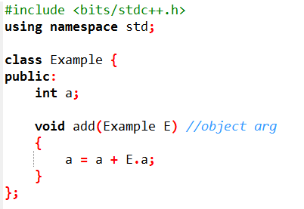
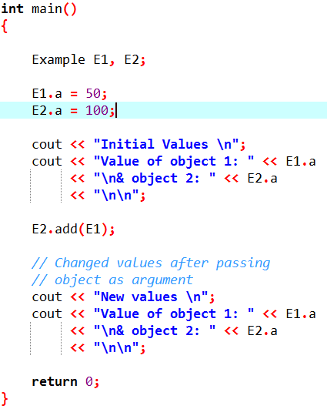

Objects passing into function

Slide 24
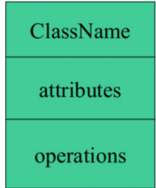
Class Diagram
The UML class symbol is formed by a rectangle divided into three sections.
The class name appears in the top section, the attributes in the middle section, and the operations in the bottom section.

Slide 25

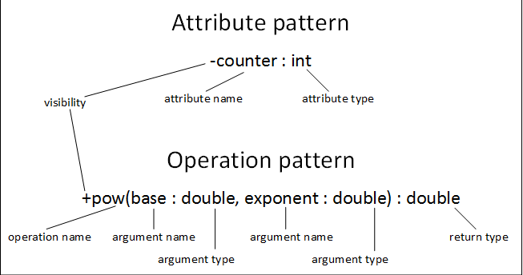
Class Diagram

Slide 26
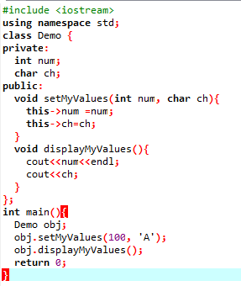

this pointer
The this pointer holds the address of current object.
this pointer points to the current object of the class.
In member function setMyValues() we have two local variables having same name as data members name.
Assign the local variable value to the data members then you won’t be able to do until unless you use this pointer, because the compiler won’t know that you are referring to object’s data members unless you use this pointer.

Slide 27
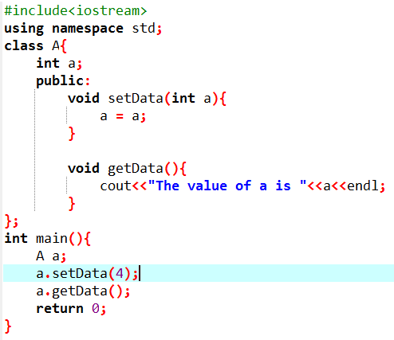
this pointer

Slide 28

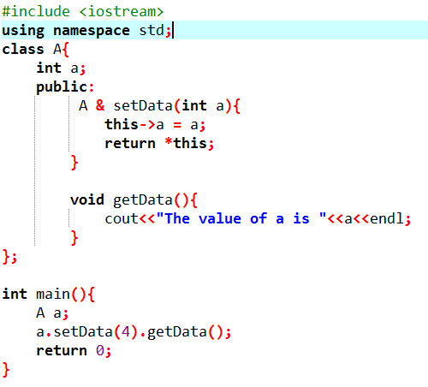
this pointer
In the function “setData” the reference of the object is returned using “this” pointer.
In the main program by using a single object we have made a chain of the function calls.
The main thing to note here is that the function “setData” is returning an object on which we have used the “getData” function.
So we don’t need to call the function “getData” explicitly.

